Slide 1

Artificial Intelligence and Expert Systems (IT-306) Project
SMS SPAM DETECTION
Under supervision of Prof. Reena Tripathi
​
Submitted by
Varun Kumar 2K19/IT/140
Yashit Kumar 2K19/IT/149
Department of Information Technology, DTU​

Slide 2
Introduction
In today’s globalized world, sms is a primary source of communication. This communication can vary from personal, business, corporate to government.
With the rapid increase in email usage, there has also been increase in the SPAM sms. SPAM sms, also known as junk sms involves nearly identical messages sent to numerous recipients by email.
Apart from being annoying, spam sms can also pose a security threat to computer system. It is estimated that spam cost businesses on the order of $100 billion in 2007.
In this project, we use text preprocessing using natural language processing to perform spam filtering to use emails effectively.
We try to identify patterns using Different classification algorithms to enable us classify the sms as HAM or SPAM. Mainly using Naïve Byes classifier which is working best to predict spam or not.

Slide 3
IMPLEMENTATION DETAILS
The main objectives of this Project are as follows:
To apply data preprocessing and preparation techniques in order to obtain clean data
Creating word dictionary and Feature extraction process
To build machine learning models able to predict whether message is spam or not.
To analyze and compare models performance in order to choose the best model
Datasets : -
The Dataset we used is a set of SMS tagged messages that have been collected for SMS Spam research. It contains one set of SMS messages in English of 5,574 messages, tagged according being ham (legitimate) or spam.
Dataset contain one message per line. Each line is composed by two columns: v1 contains the label (ham or spam) and v2 contains the raw text.
Data Cleaning and Analysis : -
We are going to make use of NLTK for processing the messages, WordCloud and matplotlib for visualization and pandas for loading data, NumPy for generating random probabilities for train-test split.

Slide 4
Text Preprocessing : - Text preprocessing is a method to clean the text data and make it ready to feed data to the model. Before starting with training we must preprocess the messages. So we perform the following steps: -
Lower case
Tokenization
Removing special characters
Removing stop words and punctuation
Stemming
Model Building : -
We trained various models namely Naive Bayes classifier , Support Vector Machines (SVM) etc. Naive Bayes classifier is a conventional and very popular method for document classification problem.
It is a supervised probabilistic classifier based on Bayes theorem assuming independence between every pair of features.
Once the classifiers are trained, we can check the performance of the models on test-set. We extract word count vector for each mail in test-set and predict its class(ham or spam) with the trained NB classifier.
Deployment : -
We deployed our machine learning model on web using streamlit framework. Now User can check spam just by copy pasting their sms with good UI.

Slide 5
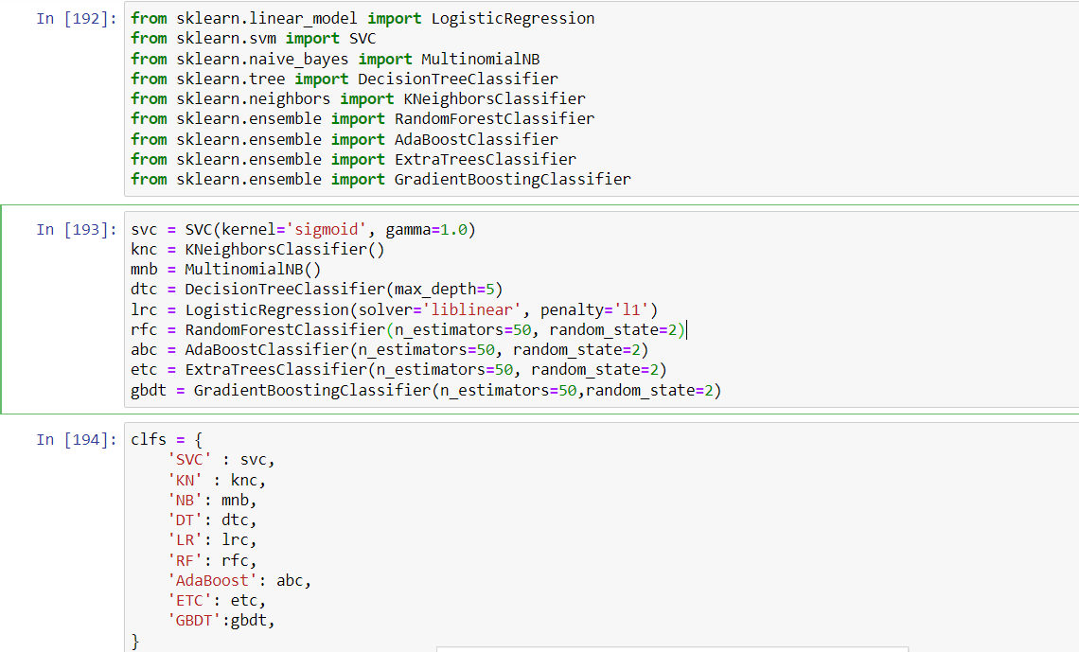
RESULTS

Slide 6
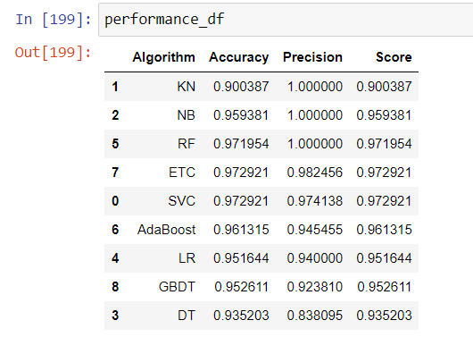
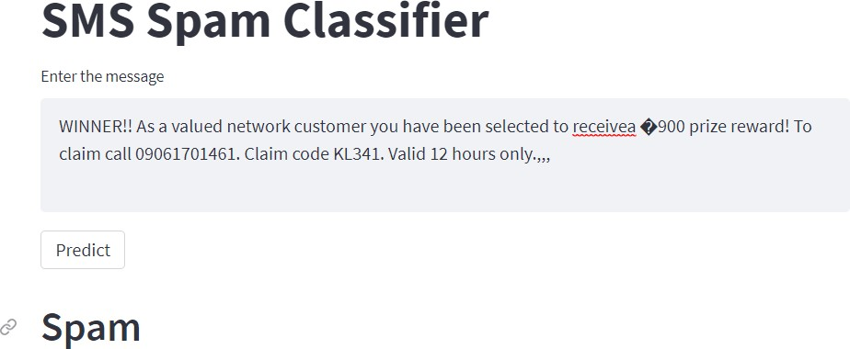
For text vectorization, First tried count vectorizer and then we tried Term Frequency Inverse Document Frequency (tfidf) vectorizer and it is giving better results
Various Classification algorithms are used to achieve better results. Out of all algorithms Multinomial Naïve Bayes algorithm is performing best and giving result with accuracy of 0.95 and precision of 1.00.

Slide 7
REFERENCES
Source Code - https://github.com/varunkmr038/Sms-Spam-Detection
Dataset: https://www.kaggle.com/uciml/sms-spam-collection-dataset
https://en.wikipedia.org/wiki/Naive_Bayes_classifier
https://www.analyticsvidhya.com/blog/2021/06/must-known-techniques-for-text-preprocessing- in-nlp/
https://medium.com/@cmukesh8688/tf-idf-vectorizer-scikit-learn-dbc0244a911a
https://www.mygreatlearning.com/blog/multinomial-naive-bayes-explained/
https://www.youtube.com/watch?v=PrkiRVcrxOs

